Slide 1
Ggplot2 and interactive graphics with R
Christophe Ladroue
SECTION 08
VIDEO 04
Making conditional panels
www.PacktPub.com

Slide 2
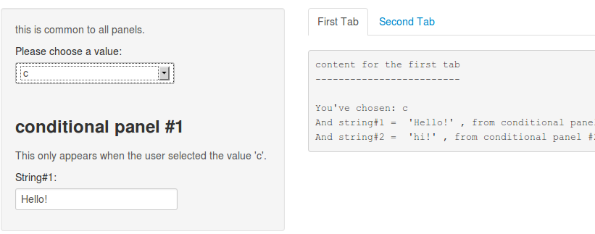
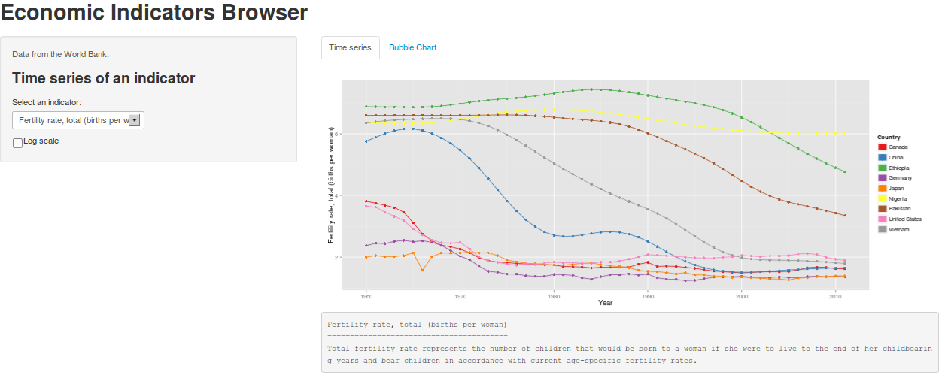
In this video we took a look at
how to make conditional panels.
Next: building our dashboard

Slide 3
In this section we’re going to take a look at
Designing the dashboard
Building the time series plot
Making a bubble chart in ggplot2
Making conditional panels
Building our dashboard

